Slide 1

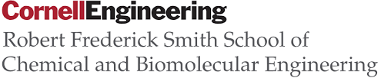
An Optimality Approach of the Leaf Stomatal Conductance
Team 11: Rui Gaoª, Sahil Desaiª, Murali Thimma Selvan Babu^{b}
CHEME 6800
12/8/2019
ª Robert Frederick Smith School of Chemical and Biomolecular Engineering, Cornell University
^{b} The School of Operations Research and Information Engineering, Cornell University

Slide 2
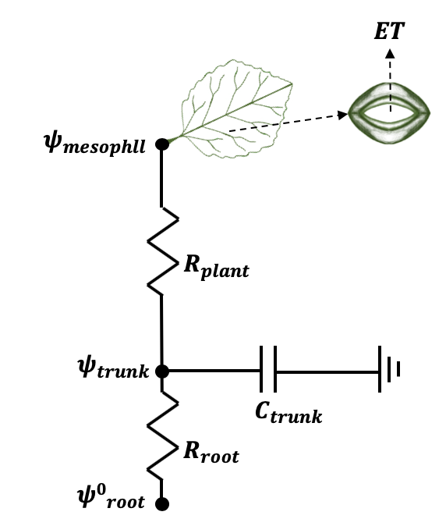
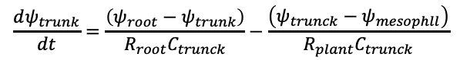
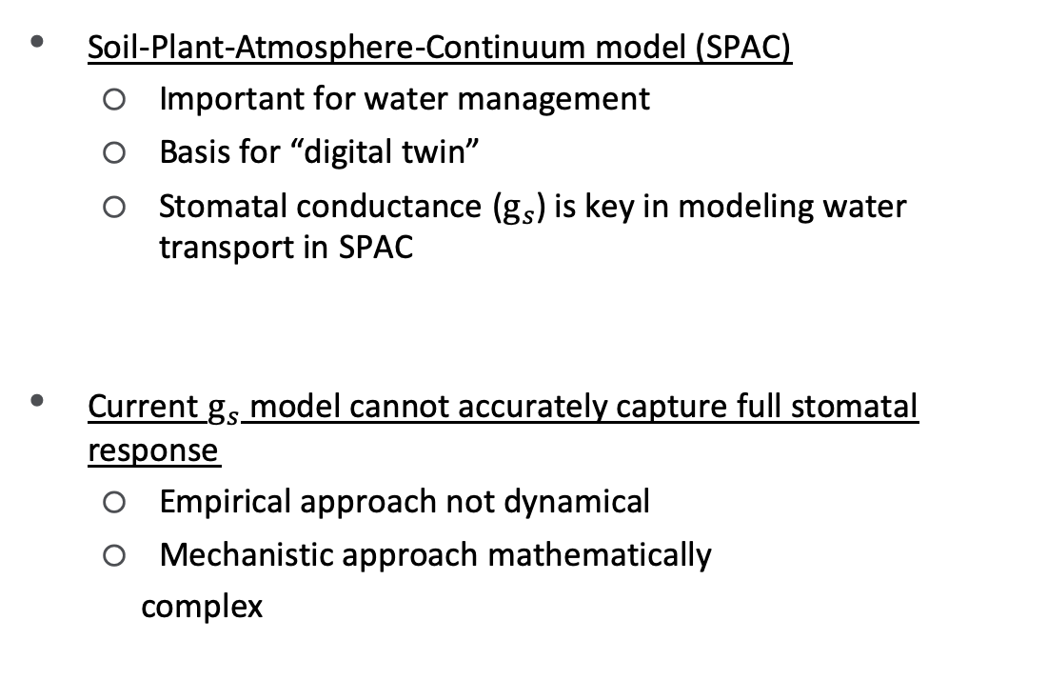
Motivation
Soil-Plant-Atmosphere-Continuum model (SPAC)
Important for water management
Basis for “digital twin”
Stomatal conductance ($g_{s}$) is key in modeling water transport in SPAC
Current $g_{s}$ model cannot accurately capture full stomatal response
Empirical approach not dynamical
Mechanistic approach mathematically
complex
$$\frac{dψ_{trunk}}{dt}=\frac{\left(ψ_{root}−ψ_{trunk}\right)}{R_{root}C_{trunck}}−\frac{\left(ψ_{trunck}−ψ_{mesophll}\right)}{R_{plant}C_{trunck}}$$
1

Slide 3
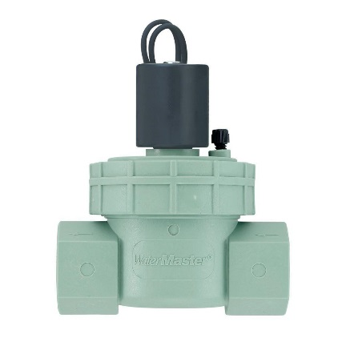
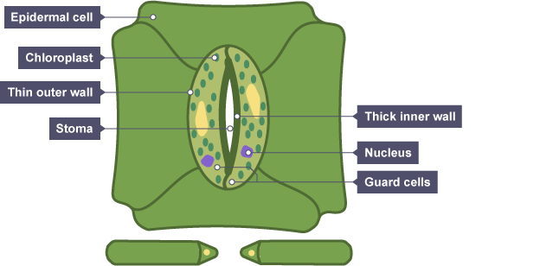
Stomatal Optimization Theory
trade-off
Photosynthetic Carbon Gain
Transpirational Water Loss
Stomata as control system (valve-like)
Regulatory role of stomata
Positive feedforward from photosynthesis
Negative feedback from leaf water potential
Short-term dynamics
No diurnal rhythm of radiation and temperature
2

Slide 4
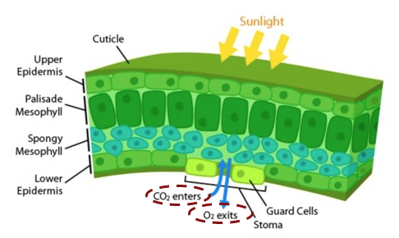

Problem Statement
Objective function
In the form of a profit function
Carbon gain maximization
Water loss minimization
Variables
Independent variable: temperature, wind speed, solar radiation
Dependent variable: stomatal conductance (g_{s})
Constraints
Farquhar’s photosynthesis model for carbon demand (A)
Delwiche’s hydraulic model for water lose (E)
(Arizona State University)
3
Notes:
A new approach that bridges the concept of constrained optimization and the stomatal mechanism may be useful to clarify the roles played by the components of the stomata.

Slide 5
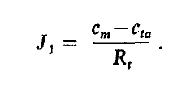
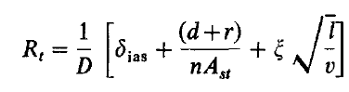
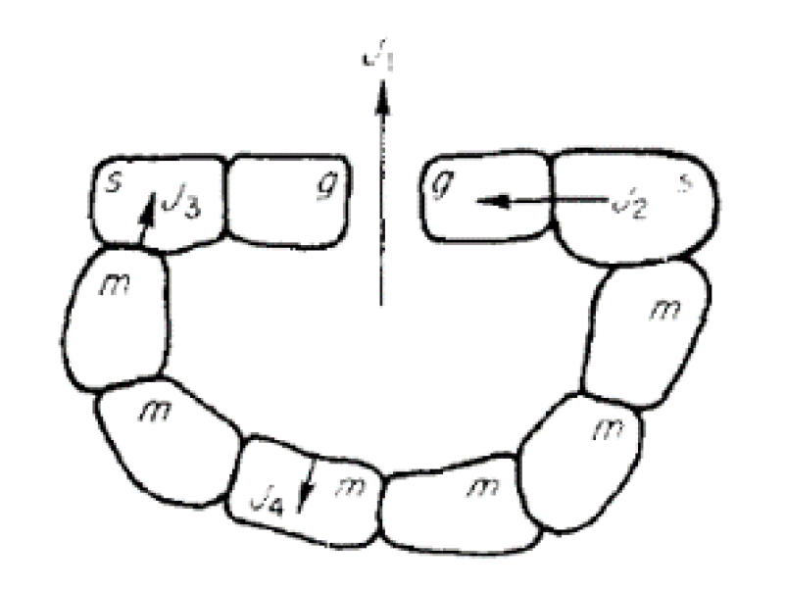
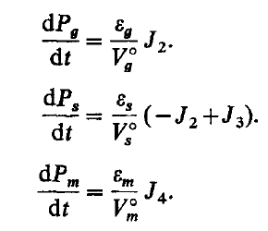
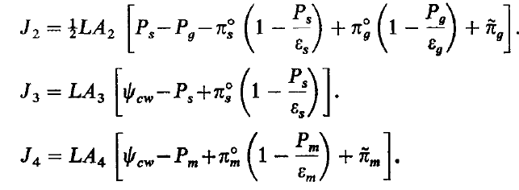
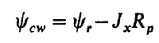
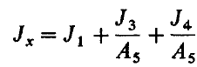
Delwiche Hydraulic Model
Simulate water and osmotic solute flow among the cells and around the stomata complex
Reductions in guard cell turgor are caused by the water potential drawdown associated with the transpirational flux.
coupled, nonlinear
ordinary differential equations
(Delwiche 1977)
4

Slide 6
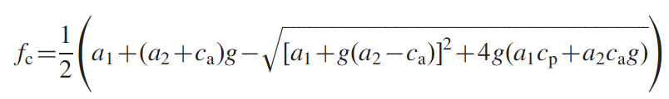
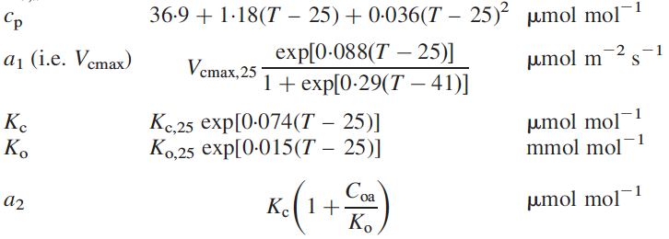
Farquhar Photosynthesis Model
CO₂ compensation point
Michaelis constant
for CO₂ fixation and oxygen inhibition
Oxygen concentration in air
(Katul 2000)
5

Slide 7
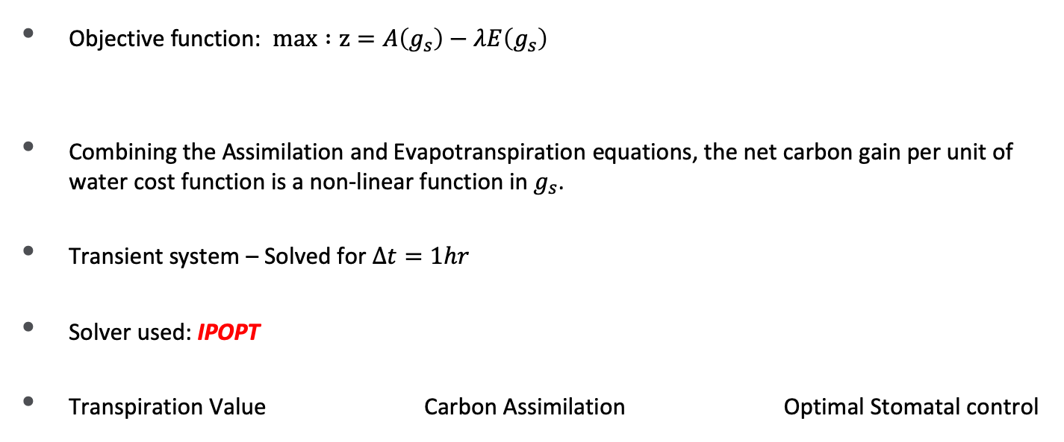
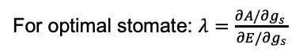
Optimization Modeling and Solution Approach
Objective function: $max :z=A\left(g_{s}\right)−λE\left(g_{s}\right)$
Combining the Assimilation and Evapotranspiration equations, the net carbon gain per unit of water cost function is a non-linear function in $g_{s}$.
Transient system – Solved for $∆t=1hr$
Solver used: IPOPT
Transpiration Value Carbon Assimilation Optimal Stomatal control
For optimal stomate: $λ=\frac{∂A/∂g_{s} }{∂E/∂g_{s}}$
7

Slide 8
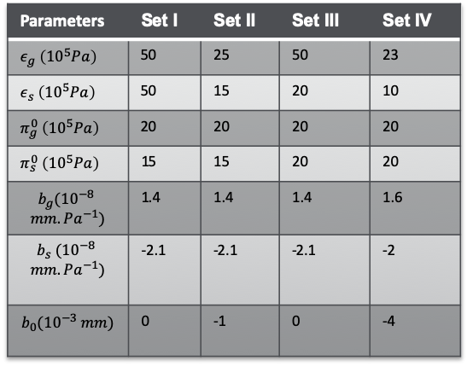
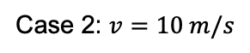
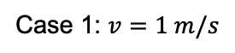
Case Study
Case 1: $v=1 m/s$
Case 2: $v=10 m/s$
Delwiche Plant Parameters:
Parameters | Set I | Set II | Set III | Set IV
$ε_{g} \left({10}^{5}Pa\right)$ | 50 | 25 | 50 | 23
$ε_{s} \left({10}^{5}Pa\right)$ | 50 | 15 | 20 | 10
$π_{g}^{0} \left({10}^{5}Pa\right)$ | 20 | 20 | 20 | 20
$π_{s}^{0} \left({10}^{5}Pa\right)$ | 15 | 15 | 20 | 20
$$b_{g}({10}^{−8}$$ $$mm.Pa^{−1})$$ | 1.4 | 1.4 | 1.4 | 1.6
$$b_{s} ({10}^{−8}$$ $$mm.Pa^{−1})$$ | -2.1 | -2.1 | -2.1 | -2
$$b_{0}({10}^{−3} mm)$$ | 0 | -1 | 0 | -4
8

Slide 9
Questions to Address
Ψ (E)
g_{s}(Ψ)
A(g_{s})
How does change in transpiration (E) affect water potential (Ψ) ?
How does change in water potential affect stomatal opening (g_{s})?
How does change in stomatal opening affect assimilation?
How does assimilation in turn affect water potential?
9

Slide 10
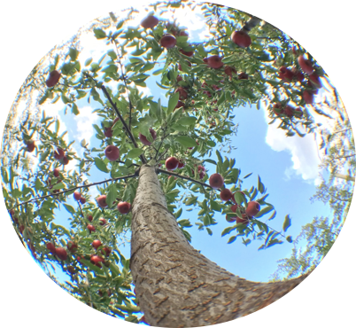
Questions?

Slide 11

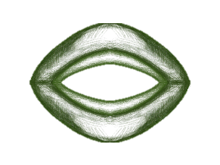
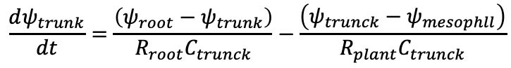
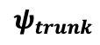
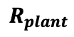
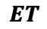
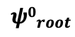
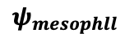
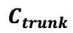
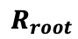
$$ET$$
$$ψ_{mesophll}$$
$$R_{plant}$$
$$ψ_{trunk}$$
$$C_{trunk}$$
$$R_{root}$$
$${ψ0}_{root}$$
$$\frac{dψ_{trunk}}{dt}=\frac{\left(ψ_{root}−ψ_{trunk}\right)}{R_{root}C_{trunck}}−\frac{\left(ψ_{trunck}−ψ_{mesophll}\right)}{R_{plant}C_{trunck}}$$

Slide 12
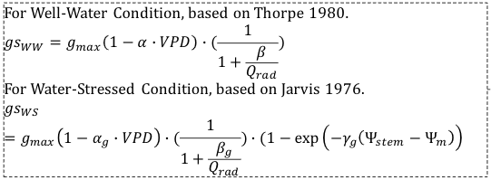
Current Model for g_{s}
This is in addition to the effects of endogenous variables impacted by soil-root-plant processes (soil, rhizosphere, and plant hydraulics. (Brodribb et al., 2003)
Relates g_{s} to exogenous environmental parameters (VPD, PAR, Ψ_{stem})
Ignores correlation between assimilation (A) and g_{s}
What about the transient state?

Slide 13
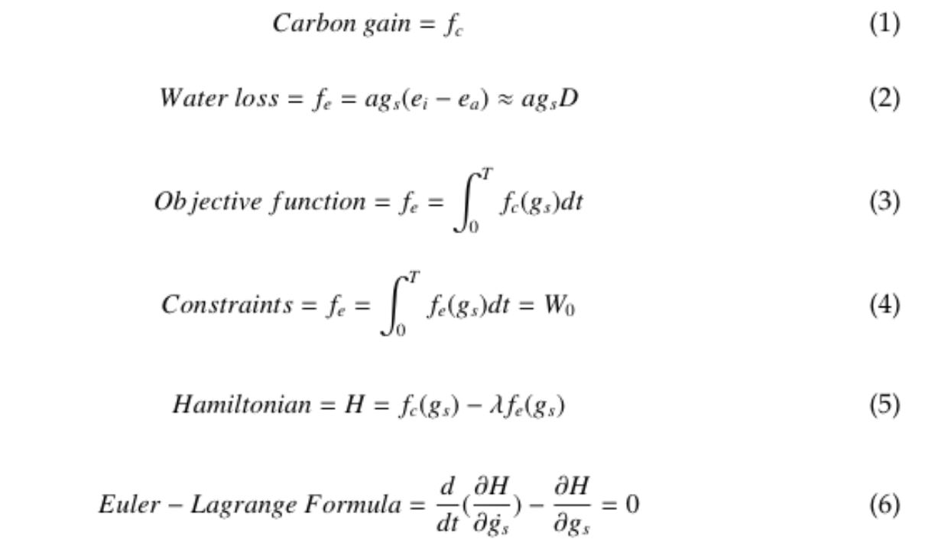
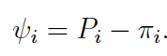
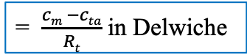
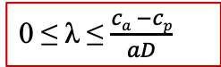
Optimization Model
= $\frac{cm −cta}{Rt}$ in Delwiche
Replace with parameters in Delwiche (P, V, π)
Use cell water relation to calculate λ
Pontryagin’s maximum principle
0 ≤ λ ≤ $\frac{ca −cp}{aD}$
(Katul et al, 2009)
8

